Slide 1

Manchester
Raspberry Jam

Slide 2
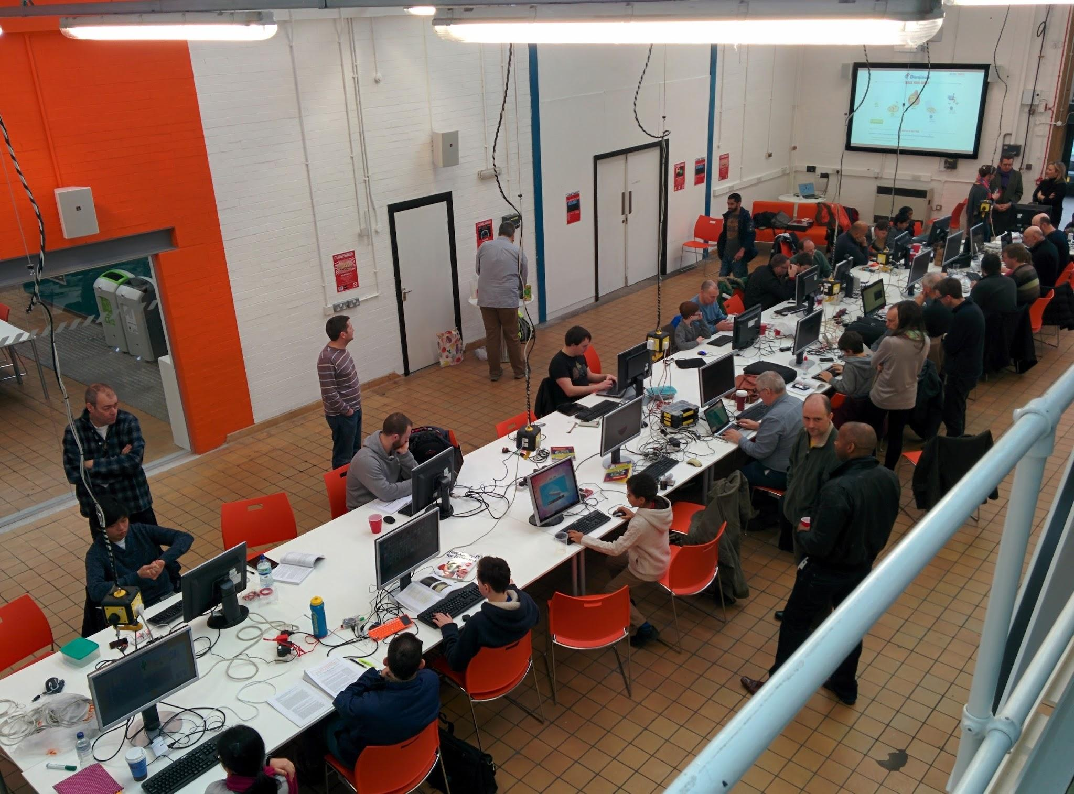

Slide 3
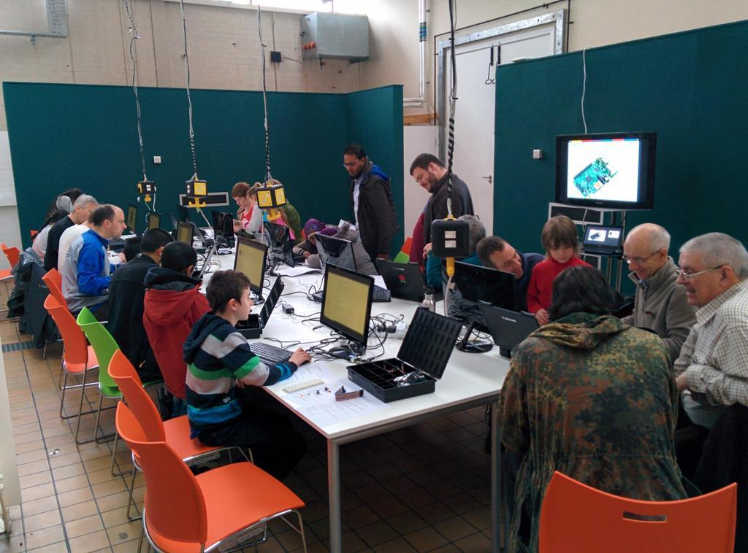
The first Raspberry Jam
Started Jun-2012 as a LUG, but now focused on education
Jam Workshops Demonstrations

Slide 4
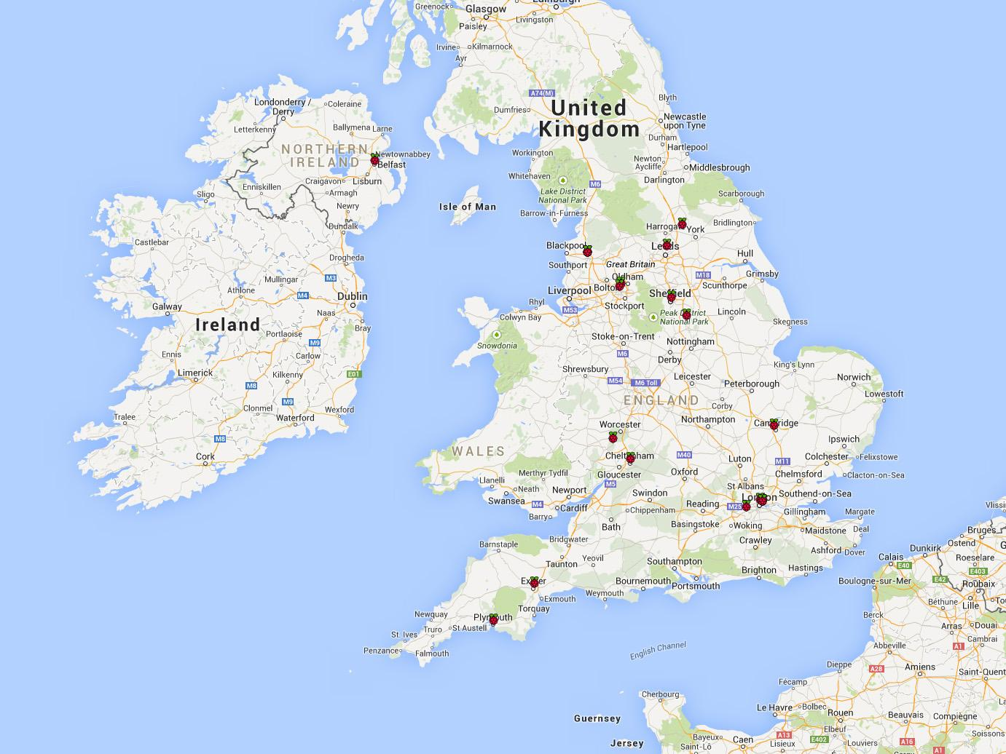
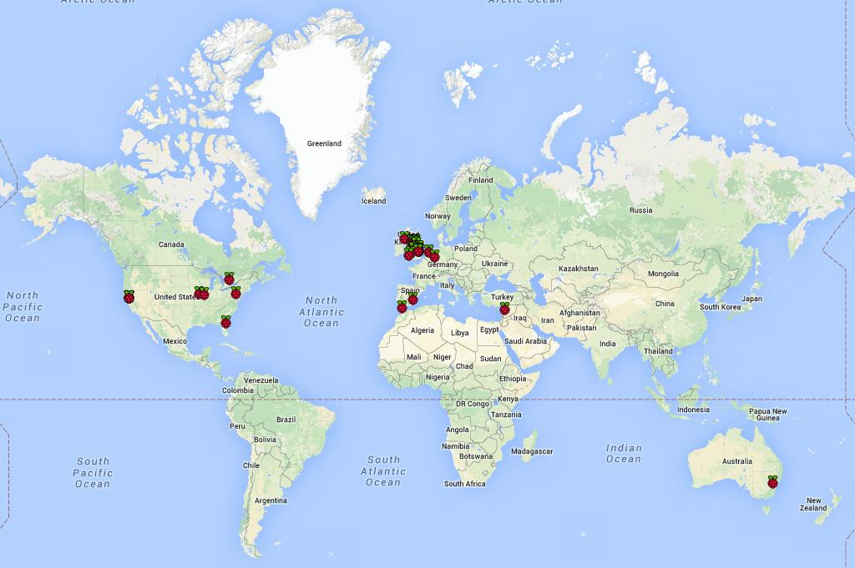

Slide 5
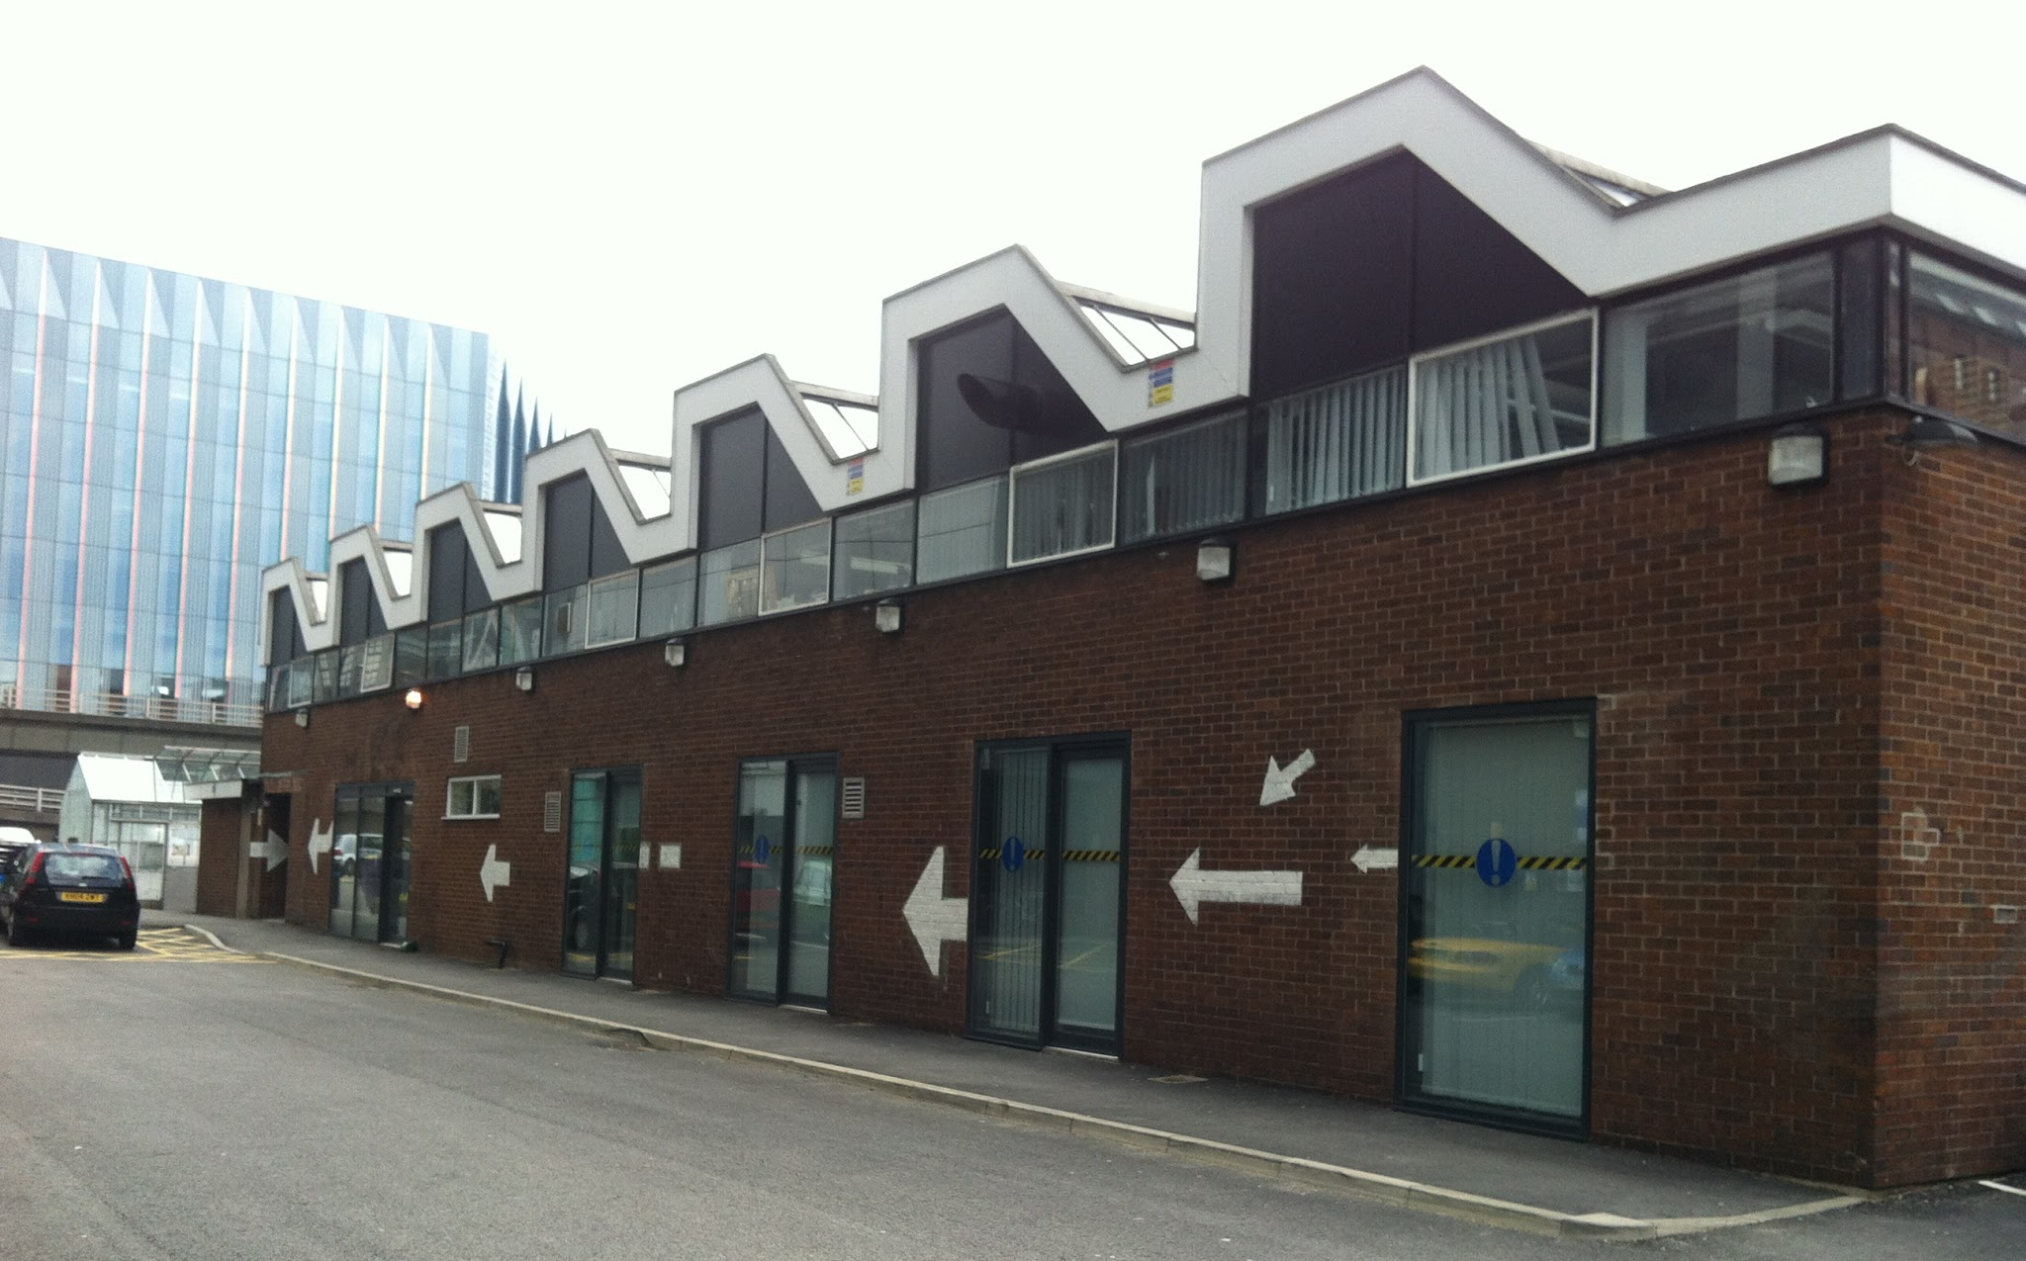


Slide 6
Join us
Interested in Raspberry Pi
Interested in education
Interested in showing something off
Interested in pizza

Slide 7
McrRaspJam.org.uk
Next event Saturday 14th March

